Slide 1
Data Science Course
Lecture 22

Slide 2
What we’ve seen so far
Jupyter notebooks.
Exploratory Data Analysis: Numpy, Pandas, basic statistics, plots, correlation.
Outliers, missing values, categoricals.
Feature engineering.
Supervised learning: classification and regression
KNN, Linear Regression, Decision Trees, Random Forest.
Gradient descent, hyperparameters.
Metrics, validation techniques, bias / variance tradeoff.

Slide 3
Next topics
NLP
Logistic regression, SVM.
Ensembles: basics, boosting.
Neural Networks.
Unsupervised learning: Clustering, PCA, SVD.
Recommender systems: collaborative filtering, evaluation.

Slide 4
Natural Language Processing (NLP)
Is a collective term referring to automatic computational processing of human languages.
“Neural Network Methods for NLP” Yoav Goldberg.

Slide 5
Language is hard
“Within a computer, natural language is unnatural” (Alan Perlis).

Slide 6
Why natural language is unnatural (for computers)
Ambiguous: “Alice Saw Bob using the telescope”
Exceptions
Noisy
Contextualized: “I had a (pizza - coke) yesterday. It was so cold!”
Common-sense: “The trophy would not fit in the brown suitcase because it was too (big - small)”.
Evolves
Language isn’t a formal system.

Slide 7
ML methods in NLP
1- Rule-based models (‘60 - ‘95)
2- Data driven (probabilistic linear models). (‘95 - 2014).
Feature engineering.
3- Learn the features. (2014 - )
Non-convex models.

Slide 8
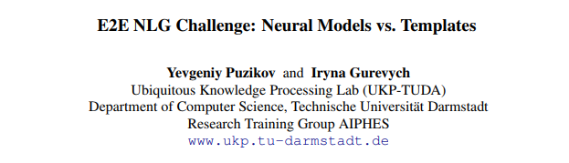
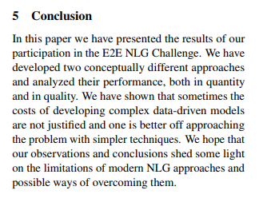

Slide 9
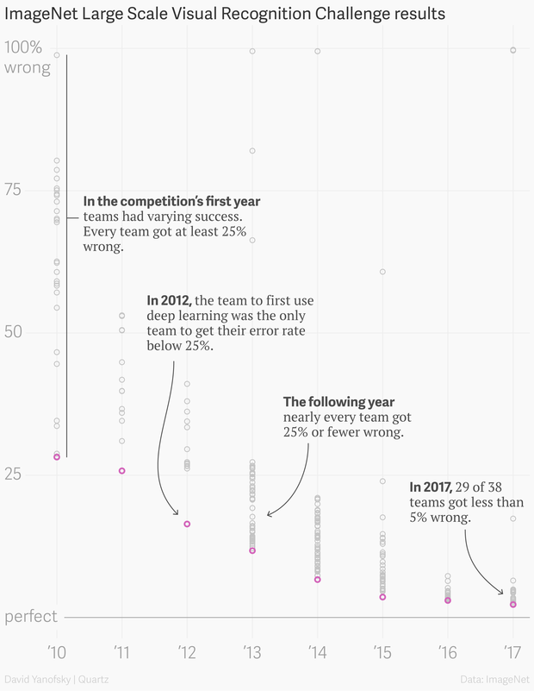

Slide 10
Deep Learning in NLP
1- Wide adoption of continuous representation.
2- New tools (Encoder - Decoder) + differentiable extensions. Sequence models without markovian assumption.
3- Removal of feature engineering.

Slide 11
Unstructured data
A lot of information in the world is unstructured — raw text in English or another human language.
How can we get a computer to understand unstructured text and extract data from it?

Slide 12
Tokenization
Process of splitting text into relevant units.
Example:
“And finally in the 110th minute Quintero blasted in a tremendous shot, making it 2-1.”
[‘And’, ‘finally’, ‘in, ‘the’, ‘110th’, ‘minute’, ‘Quintero’, ‘blasted’, ‘in’, ‘a’, ‘tremendous’, ‘shot’, ‘,’, ‘making’, ‘it’, ‘2’, ‘-’, ‘1’]

Slide 13
Numerical representation
The next step is to create a numerical feature vector for each document:
Bag-of-words

Slide 14
Pre-processing
POS: nouns, pronouns, adjectives, verbs, adverbs, prepositions, conjunctions and interjections.
Stemming: a stemming algorithm might reduce the words fishing, fished, and fisher to the stem fish.
Lemmatization.
Stopwords removal.
Dependency parsing.
NER.

